Slide 1




Update Since PRAGMA 11
PRAGMA 12
“The Fellowship of the Grid”
Bangkok
20 – 22 March 2007

Slide 2
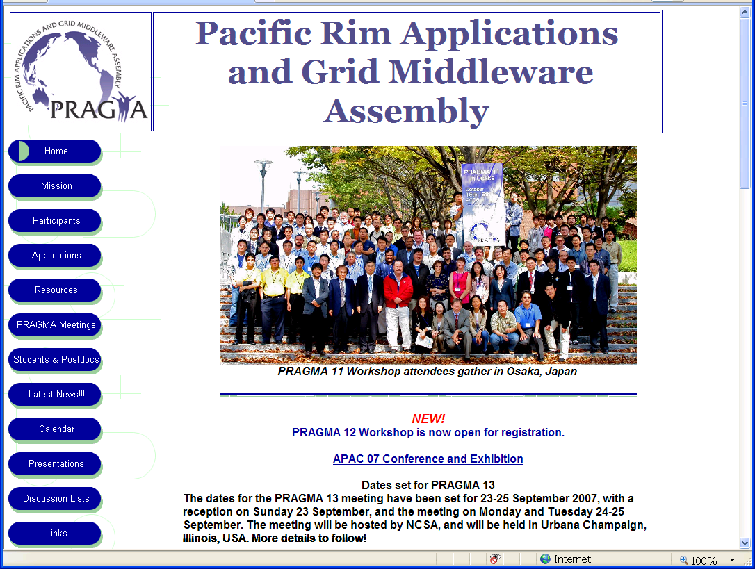

Slide 3
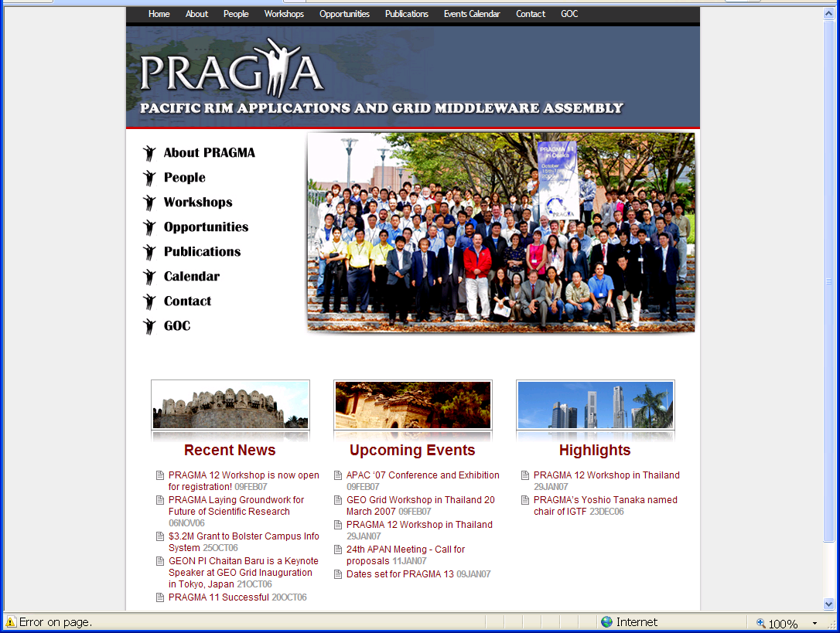
Thanks to
Teri Simas
Tomas Molina
George Yang
Notes:
APAC’07 – PRAGMA is supporting – vote of Steering Committee
Others to thank
Chris Misleh
Arya ??

Slide 4

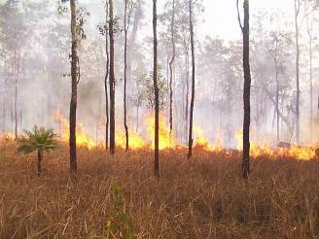
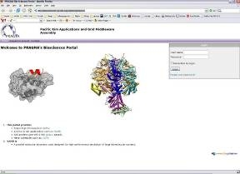
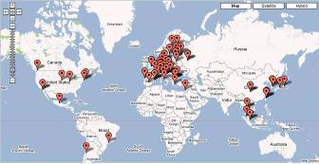
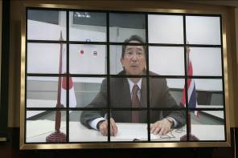
PRAGMA Highlights of 2006 - 2007
Simulating the Australian Monsoon and the Effect of Wildfires
PRAGMA Biosciences Portal
PRAGMA Leads Application Experiment of Grid Interoperation in GIN Testbed
PRAGMA Establishes Certificate Authority (CA) Using Naregi-CA Software
Expanding the Collaboration Grid
Building Communities, Catalyzing Collaborations
PRIME and PRIUS
More accomplishments in the Working Group sections

Slide 5
Presentations at SC06:
16 Presentations, 14 members
RESOURCES AND MIDDLEWARE: Mason Katz
GIN and Testbed, Cindy Zheng
APGrid PMA, Yoshio Tanaka
SCMSWeb and Monitoring, Putchong Uthayopas
HPC Storage Challenge, Osamu Tatebe
GLORIAD, GLIF, SAGE and Visualcasting, Maxine Brown
TransPAC2, R/E networking in the U.S. and Asian-Pacific region, John Hicks
Research Channel, Jacqueline Brown, Jim DeRoest
APPLICATIONS AND MIDDLEWARE: Fang-Pang Lin
EcoGrid and GLEON, Fang-Pang Lin
GEOGrid, Satoshi Sekiguchi
e-Science Portal and Biomed Application Framework, Hsin-Yen Chen
Application Portals and MPICH-GX Implementation, Kum Won Cho
NCSA PRAGMA activities - PRAGMA 13 Radha Nandkumar
Grid activities in APAN, Kento Aida
EDUCATION, APPLICATIONS, and MIDDLEWARE: Philip Papadopoulos
Telescience and collaborative educational activities in Osaka University, Shinji Shimojo / Susumu Date
BioSciences Portal and Tools, Wilfred Li
PRIME, Peter Arzberger
Notes:
16 Presentations by 14 members

Slide 6

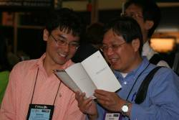
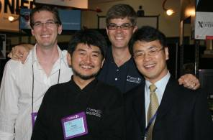
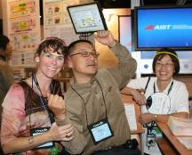
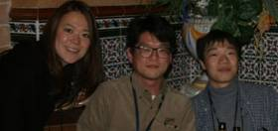
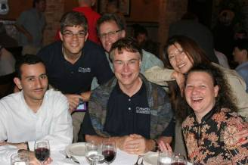
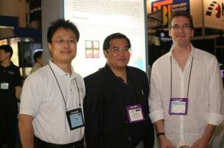

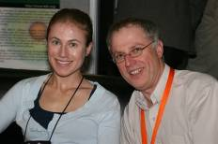
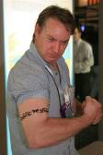
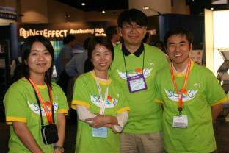

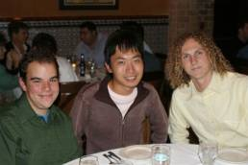
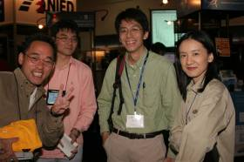
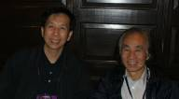
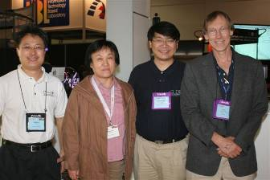
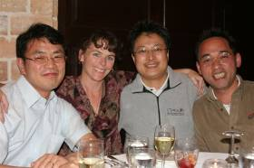
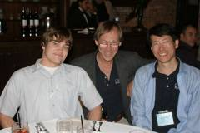
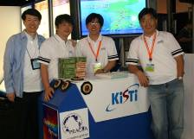
Photos from SC06

Slide 7
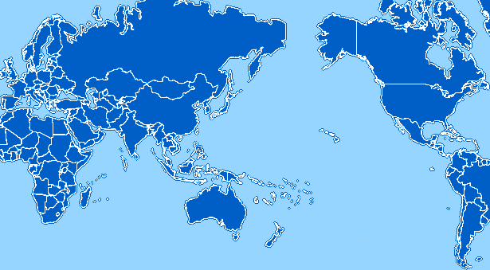
PRAGMA Grid Testbed
CNIC
GUCAS
China
JLU
China
AIST
OsakaU
UTsukuba
TITech
Japan
NCSA
USA
UZurich
Switzerland
CNIC
KISTI
Korea
AIST
BU
USA
UUtah
USA
SDSC
USA
SDSC
LZU
China
ASGC
NCHC
Taiwan
ASGC
CICESE
Mexico
UMC
USA
UoHyd
India
CUHK
HongKong
UNAM
Mexico
NECTEC
ThaiGrid
Thailand
NECTEC
ThaiGrid
IOIT-HCM
Vietnam
ASURC
Costa Rica
APAC
QUT
Australia
MIMOS
USM
Malaysia
BII
IHPC
NGO
Singapore
UCN
Chile
NGO
BESTGrid
New Zealand
MU
Australia
UChile
Chile
32 Clusters from 29 institutions in 14 countries/regions (+ 7 in preparation)
7 gfarm sites
Source Cindy Zheng

Slide 8
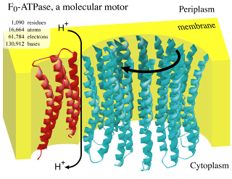
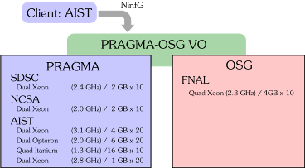
Additional Resources Updates
PRAGMA production CA is in final stages of testing
GIN:
  Savannah burn running on Teragrid, OSG, and PRAGMA Grid.
  Data intensive application
Open Science Grid
  Working on interoperability, using FMO as PRAGMA application
  Hoping to use their technology in PRAGMA (e.g. Virtual Data Toolkit)
Source: Tsutomu IKEGAMI

Slide 9
Biosciences
Distributed Bioinformatics Analysis of Avian (Bird) Flu using Global Computational Data Grid: Integration of PRAGMA Resources
  Goals
    Characterize function of Influenza viruses using structure based approach
    Understand interactions of major viral virulence determinants using molecular dynamics (MD) simulations
    Establish a large scale distributed computational data grid among participating institutions through multinational collaboration
  Funded by Telemedicine and Advanced Technology Research Center (TATRC) -United States Army Medical Research and Material Command
  Collaboration involves
    National Institute for Advanced Industrial Science and Technology (AIST) and U Tsukuba [Gfarm]
    Jilin University [Community Grid Scheduler]
    Computer Network Information Center (CNIC) of the Chinese Academy of Sciences [Transparent web service layer for data access; central repository of project data]
    Korea Institute for Science and Technology Information (KISTI), Konkuk University, and the Korean National e-science project (MOST) [Integrated portal environment for the computational pipeline]
    University of Hawaii [Analyze the biosynthetic pathways]
    National Biomedical Computation Resource at UCSD [Engage computational approaches]

Slide 10









Biosciences:
Distributed Bioinformatics Analysis of Avian (Bird) Flu using Global Computational Data Grid: Integration of PRAGMA Resources
  Funded by Telemedicine and Advanced Technology Research Center (TATRC) -United States Army Medical Research and Material Command
  Involves students in PRIME
Collaboration involves
  National Institute for Advanced Industrial Science and Technology (AIST) and U Tsukuba
  Jilin University
  Computer Network Information Center (CNIC) of the Chinese Academy of Sciences
  Korea Institute for Science and Technology Information (KISTI), Konkuk University, and the Korean National e-science project (MOST)
  National Biomedical Computation Resource at UCSD
  University of Hawaii
  Universiti Sains Malaysia

Slide 11
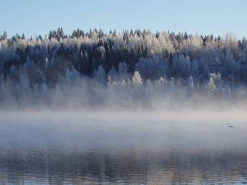
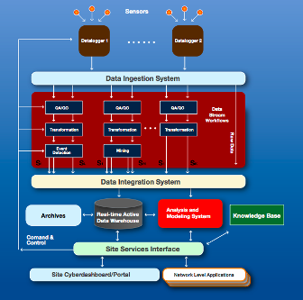

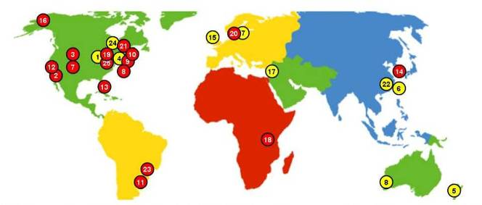
Telescience
GLEON 4: Lammi Biological Station, Finland, 2- 5 March 2007 (NCHC, UCSD, *)
Additional Funding from NSF for a Research Coordination Network to expand network
Advances in Streaming Data Architecture
Lake Pääjärvi Dec 18,2006
Source: L Arvola
15
Tony Fountain
Sameer Tilak
Ken Chiu
et al.

Slide 12

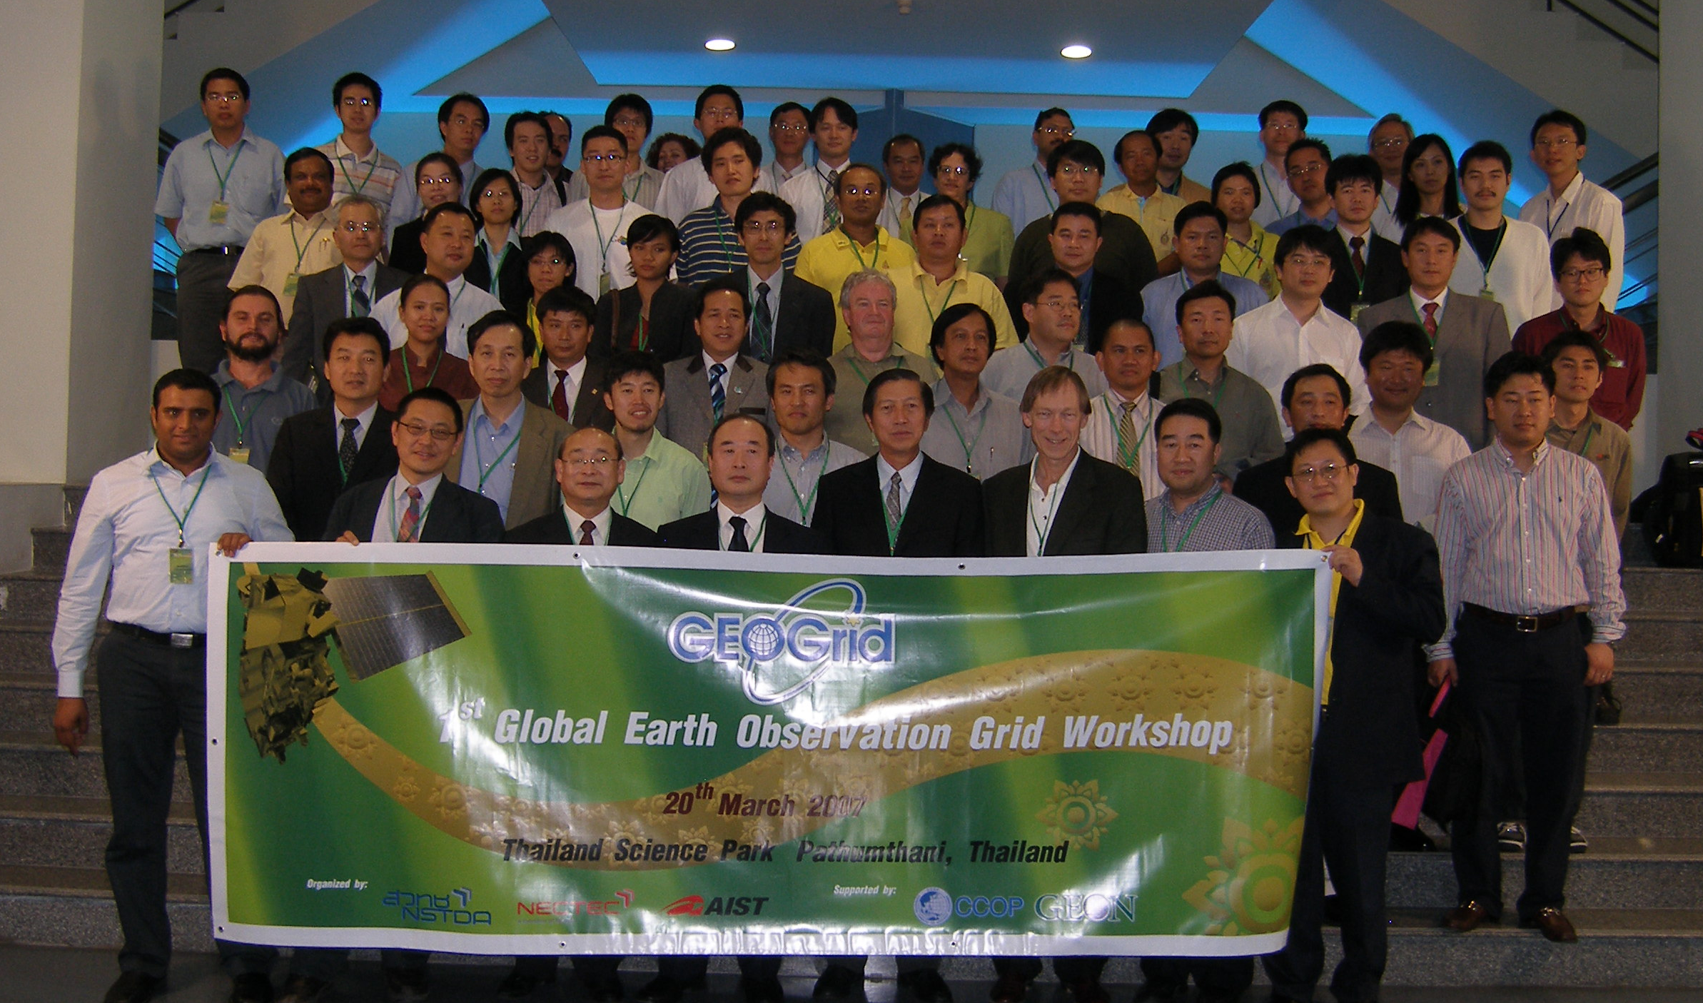
GEO Working Group
GEOGrid: 1st Global Earth Observation Grid Workshops
  Held Meeting 20 March 2007
  Thailand Science Park
  Hosted by AIST, NECTEC
    Supported by CCOP and GEON
      CCOP: Coordinating Committee for Geosciences Programs in East and South East Asia
      GEON: GEOsciences Network
Proposal to become official working group
  With Leadership
    Ryosuke Nakamura, AIST
    Guey-Shin Chang, NARL
    Ashram Memon, SDSC
    Sornthep Vannarat, NECTEC
  With Initial Objectives:
    Focus on accessing either large data or distributed data
    Interoperability test between GEON/GEO Grid data-search web-service

Slide 13
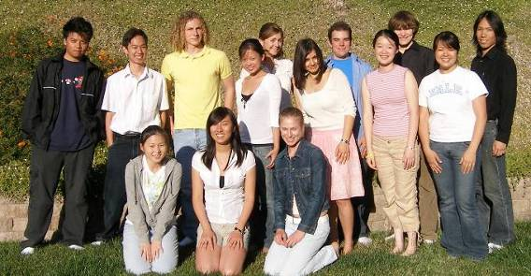
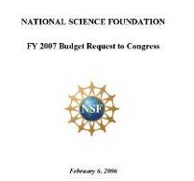
PRIME: Providing Students International Interdisciplinary Research Internships and Cultural Experiences preparing the global workplace of the 21st century
  Computer Network Information Center (CNIC), Chinese Academy of Sciences
  Cybermedia Center (CMC), Osaka University, Japan
  Monash University, Australia
  National Center for High-performance Computing (NCHC), Taiwan
PRIME Class 2006
Built on top of PRAGMA people network and activities for Undergraduate Research
A Pilot Project for Global Engagement
prime.ucsd.edu
Notes:
Please note the 2006 class had more women than men
Mostly engineers (although one visual arts, two science)
Distribution of students
CNIC – 3
Monash – 4
CMC/Osaka – 4
NCHC/NCREE – 3 (2/1)
Topics: Avian Flu, Astronomy and TDW, docking simulations, cardiac modeling, signal detection, earthquake engineering, visualization with TDW

Slide 14
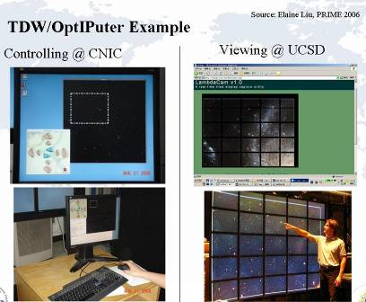
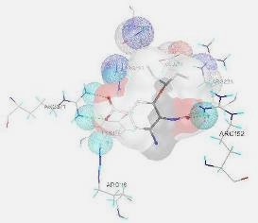

PRIME 2007
Fourth year of program
Projects (some)
  Avian Flu (CNIC)
  Molecular Screening (Osaka)
  Quantum Chemistry (Monash)
  Tile display walls (CNIC, NCHC, Osaka)
  Cardiac Modeling (Monash, Osaka)
  Computational materials modeling (NCHC)
Mixture of new projects and continuing ones
Total number of students: 16
On YouTube:
http://www.youtube.com/
watch?v=4lY6x0S3IoA
Goggle:
YouTube PRIME Video
Multimedia:
- Research
- Culture
Source:
L. Cheng
Notes:
Here is an image with Tamiflu bound to Neuraminidase from H5N1 as viewed through ADT's View Docking in Context feature. Broken green dots shows hydrogen bonds. Spheres shows atoms that interact with the ligand. Dark colored molecular surface of the ligand represent those with interactions to the receptor. Red is oxygen atom, Blue is nitrogen, and blue is added hydrogen atoms.
These can be found at:
http://video-jsoe.ucsd.edu/calit2/PrimeNSF.wmv *
or see http://www.youtube.com/watch?v=4lY6x0S3IoA)
*To download the .wmv file, go to http://video-jsoe.ucsd.edu/calit2/ and right-click on the PrimeNSF.wmv file then Save Target As... to any directory on the PC. After that click on the file, and it should launch the Windows Media player automatically.

Slide 15



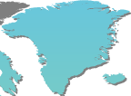

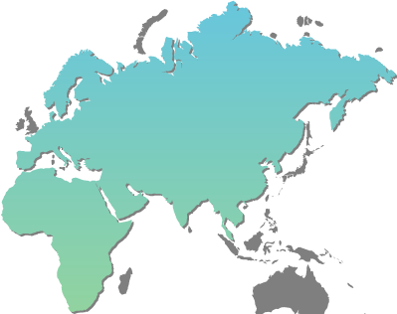








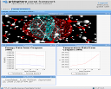








Fostering of Globally-Leading Researchers in Integrated Science (PRIUS)
Educational Network linking 13 organizations
in 7 countries centered around the Pacific Rim
Ａｃｈｉｅｖｅｍｅｎｔ ２００６（２００５)：
# of PRIUS-Invited lecturers １３ （６）
# of Internship Students ４ （１）
“Studies on International Integrated Science I, II”
University of Illinois,
Chicago
Harbin Institute of Technology
University of Zurich, Irchel
University of California,
San Diego
National Center for
High-performance Computing
University of Malaysia
Nanyang Technological
University
Queensland University of Technology
QM/MM simulation
Using OPAL OP
Bioscience GridPortal
University of Melbourne
Invited Lecturer
Security Monitoring System
Based on MOGAS
Internship
Student
University of Canterbury
PRIUS URL: http://prius.ist.osaka-u.ac.jp
Augment Reality toolkit

Slide 16

Fostering of Globally-Leading Researchers in Integrated Science (PRIUS)
Scheduled class for the first semester in 2007 (Apr. 2007 – Sep. 2007)
Apr. 11, 12: Dr. Mason J. Katz
from San Diego Supercomputer Center,
University of California, San Diego, USA
May. 07, 09: Dr. Philip Papadopoulos
from San Diego Supercomputer Center,
University of California, San Diego, USA
Jun. 25, 27: Prof. Mark Ellisman
from Department of Neurosciences,
University of California, San Diego, USA
Jul. 02, 04: Prof. Moon-Gil Yoon
from Department of Management Science,
Hankuk Aviation University, Korea
Jul. 09, 11: Prof. Oliber Bimber
from Faculty of Media,
Bauhaus University, Weimar, Germany
Jul. 16, 18: Prof. David Abramson
from Clayton School of Information Technology,
Monash University, Australia
Scheduled Lecturer
PRIUS URL: http://prius.ist.osaka-u.ac.jp

Slide 17

PRAGMA Institute
Approved by Steering Committee
22/21 February 2007
Goal: Build the community of researchers in the Pacific Rim who use grid technologies by providing training opportunities.
Duration: Likely a week
Frequency: Depends on demand
PRAGMA Involvement:
  Hosting sites are PRAGMA members
  Lecturers are from PRAGMA institutions
  Program Committee to include PRAGMA members
Participants: PRAGMA and non-PRAGMA
Proposals: Steering Committee will review
First Institute: ??

Slide 18
Groups to Welcome
Thailand
  Chulalongkorn University: Anat Ruangrassamee, Natawut Nupairoj
  Hydro and Agro Infomatics Institute: Royol Chitradan
  Shinawatra University: Maruf Hasan
  Ubon Ratchathani University: Siriporn Jungsuttiwong
New
  Communication and Network Center, Lanzhou University: Yan Hao, Zhang Yang
  Hanoi University of Technology: Nguyen Thanh Thuy; Kim Khanh Nguyen
  HCMC Institute of Information Technology: Tuyet Dao Van; Long Do Van
  Institute of Geography, Vietnam: Nguyen Dinh Duong
  National Cheng-Kung University, Taiwan: Ce-Kuen Shieh
  Universiti Malaya: Noorsaadah Abd. Rahman, Chee-Sun LIEW, Sharifuddin Zain
  University of Sonora: María del Carmen Heras
  University of Waikato, and Research and Advanced Network NZ: Lex Chalmers
  U Western Australia: Jane Klobas
Mostly New
  Altair Engineering: Raj Chhabra
  Center for Internet Augmented Research & Assessment (CIARA): Heidi Alvarez and Julio Ibarra
  Costa Rican Institute of Technology: Jose Castro
  Department of Posts and Telematics, Hochiminh City, Vietnam: Hoang Le Minh
  Konkuk University: Karpjoo Jeong; Youngjin Choi; HyungSeok Kim; Hanku Lee; Sang Boem Lim; Mu Wook Pyeon; Sunwoo Young;
  ITSC, The Chinese University of Hong Kong: Sammy Tang
  Nanyang Technological University: Francis Lee
  Nara Institute of Science and Technology: Kazutoshi Fujikawa
  National Applied Research Laboratory: Guey Shih Chang; Cheyenne Chen
  Seoul National University: Heon Yeom; Hyungsoo Jung
  U. Canterbury, NZ: Neil Gemmell
  U. Utah, USA: Thanh Truong

Slide 19
New Project Areas
Geo Projects: Ryosuke Nakamura; Guey-Shin Chang, NARL; Ashram Memon, SDSC; Sornthep Vannart
Earthquake Engineering: Follow-up to PRAGMA 8 meeting in Singapore of international groups. Lelli Van Den Einde, SDSC
CAMERA (Metagenomics): Kayo Arima, UCSD
Global Cyberbridges: Heidi Alvarez, CIARA
  Collaboration with CNIC and FIU and others (City University Hong Kong; University of Sao Paulo, Brazil)
Social Dimensions of Engaging New Communities: Grace Hong, London School of Economics

Slide 20

Agenda of the Steering Committee
Business
  New Member: Konkuk University
  GEO Working Group: Mission / Goals / Concrete action
  Steering Committee Composition and Rotation schedule
Briefing on Study of PRAGMA Group Dynamics
Discussion
  PRAGMA in 2011: Where do we want to be with respect to PRAGMA Grid, Scientific results produced, new application areas, education programs?
  Hosting a Workshop: Adjusting the approach to support “hosting” a meeting
  New Collaborative Overview Format: The current format is does not scale as the number of institutions increases.
  Funding Models for PRAGMA: Discuss how to develop other non-NSF support.
  Role of Industry: This is closely related to the funding model of the future.

Slide 21




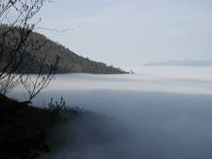



Future PRAGMA Workshops
20 – 22 March 2007, Bangkok Thailand
  PRAGMA 12 Hosted by NECTEC and Thai National Grid Center,
  20 March 2007: GEOGrid Workshop
23 – 25 September 2007, Urbana-Champaign Illinois USA
  PRAGMA 13 Hosted by NCSA
Spring 2008, Hsinchu Taiwan
  PRAGMA 14 Hosted by NCHC
Fall 2008, Penang Malaysia
  PRAGMA 15 Hosted by USM

Slide 22
Challenges
PRAGMA in 2011
  Science
  Software Integration
  Students
Resources
  Use the PRAGMA Grid to create new science insights
  Make the grid easy to use
Resources and Telescience
  Extend the PRAGMA Grid to sensor
Telescience
  Extend the use of Tile Display Walls
Geosciences and Resources
  Push the development of the data grid
Biosciences
  Integrate technologies

Slide 23
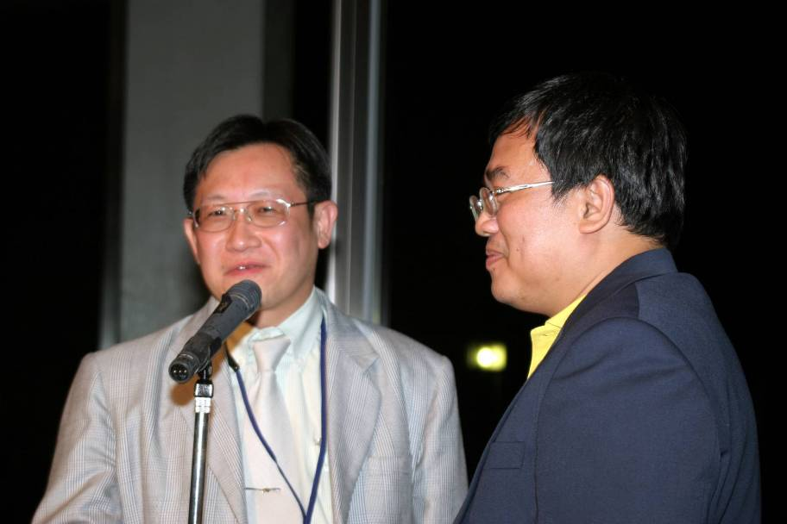
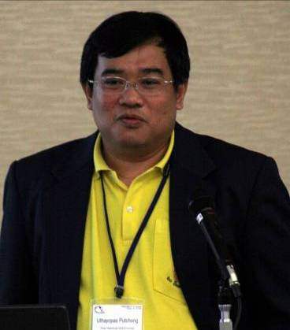

Slide 24
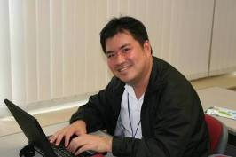
Thank you
Local Organizing Committee
  Sornthep Vannarat
  And many others
Program Committee
  Satoshi Sekiguchi, AIST
  YoshioTanaka, AIST
  Kai Nan, CNIC
  Kum Won Cho, KISTI
  David Abramson, Monash U.
  Fang-pang Lin, NCHC
  Radha Nandkumar, NCSA
  Piyawut Srichaikul, NECTEC
  Sornthep Vannarat, NECTEC
  Jon Lau Khee Erng, NGO
  Kazunori Nozaki, Osaka University
  Susumu Date, Osaka University
  Putchong Uthayopas, TNGC
  Jim Williams, TransPac
  Mason Katz, UCSD
  Peter Arzberger, UCSD
  Cindy Zheng, UCSD
  Arun Agarwal, UOH
  Habibah Wahab, USM

